Slide 1
Section 10.3 Confidence Interval for Estimating a Population Proportion

Slide 2
What’s Important in this lesson?
The purpose of this lesson is to find a “C” confidence interval for a population proportion
Note: the range for a population proportion is from 0 to 1
We are dealing with proportion if our random variable of interest is “binary”
The proportion we are looking for is the percentage of the observations that fall into one of the two categories…
ie: What percentage of the males in North America is color blind?
Random variable of interest → (2 categories/BINARY) individual is color blind OR Not color blind
Proportion → Looking for a percentage of the population that fall into one of these categories
Confidence Interval:

Slide 3
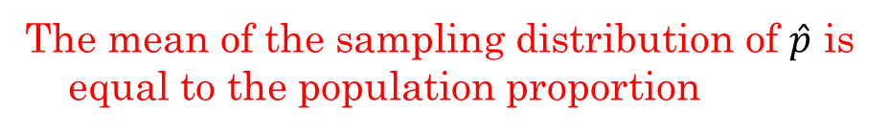
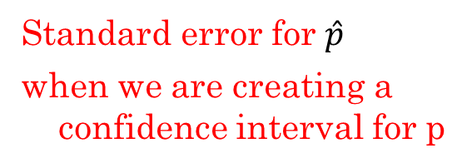
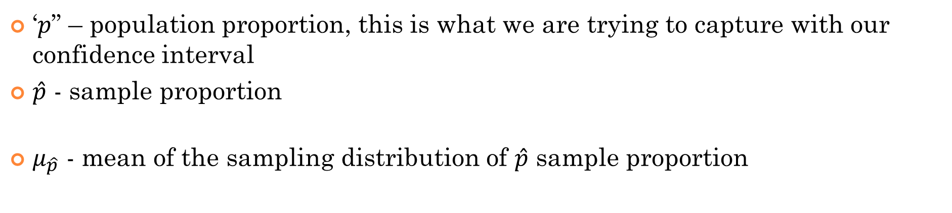
Notations for this section: ‘$p$”, $\hat{p}$ , $μ_{\hat{p}}$, and $σ_{\hat{p}}$
‘$p$” – population proportion, this is what we are trying to capture with our confidence interval
$\hat{p}$ - sample proportion
$μ_{\hat{p}}$ - mean of the sampling distribution of $\hat{p}$ sample proportion
The mean of the sampling distribution of $\hat{p}$ is equal to the population proportion
According to the C.L.T. if conditions are met, the distribution of $\hat{p}$ is normally distributed, with a mean of $μ_{\hat{p}}$ and a standard error of $σ_{\hat{p}}$
Standard error for $\hat{p}$
when we are creating a confidence interval for p
Can’t use ‘p’ for confidence interval because we don’t have it!!!!!

Slide 4
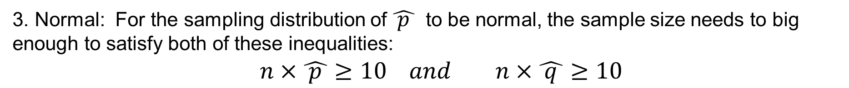
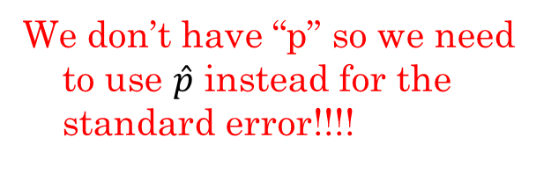
Conditions for Sampling Distribution of $\hat{ p }$
The are the conditions required for the sampling distribution of $\hat{ p }$ to be normally distributed:
1. Simple Random sample: Every observation in the population is equally likely to be chosen
2. Independence: Every observation in the sample must be independent of one another
3. Normal: For the sampling distribution of $\hat{ p }$ to be normal, the sample size needs to big enough to satisfy both of these inequalities:
$n×\hat{ p }≥10 and n×\hat{ q }≥10$
When these conditions are met, the distribution of $\hat{ p }$will be normally distributed with a mean of $μ_{\hat{p}}$ and standard error of $σ_{\hat{p}}$
We don’t have “p” so we need to use $\hat{p}$ instead for the standard error!!!!
Population size must be 10 times or greater than the sample size. This condition must be met to use the standard error formula

Slide 5
Formula for Confidence Interval for Capturing Population Proportion
NOTE: When looking for the confidence interval, WE DON’T have ‘p’, population proportion, so $\hat{ p }$ is used for the margin of error
Standard error is just another way of saying standard deviation
Critical z* value, depends on level of confidence

Slide 6
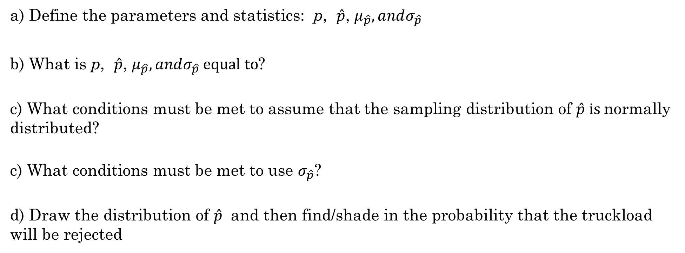
Practice: Finding probability of a Sample Proportion:
Ex: Suppose your job at a fruit warehouse is to check each shipment of bananas for quality assurance. A truckload has 95% of it’s bananas that is acceptable for processing. If we take a SRS and more than 10% are found to be unacceptable, then you must reject the shipment. To inspect the shipment, you randomly test 200 bananas.
a) Define the parameters and statistics: p, $\hat{p}$, $μ_{\hat{p}}, andσ_{\hat{p}}$
b) What is p, $\hat{p}$, $μ_{\hat{p}}, andσ_{\hat{p}} equal to$?
c) What conditions must be met to assume that the sampling distribution of $\hat{p} is$normally distributed?
c) What conditions must be met to use $σ_{\hat{p}}$?
d) Draw the distribution of $\hat{p}$ and then find/shade in the probability that the truckload will be rejected

Slide 7
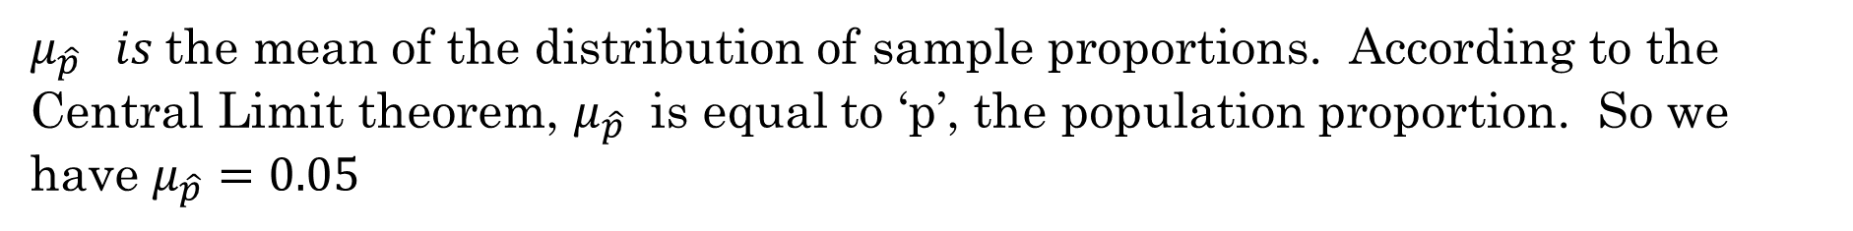
Answer: ‘p” can be defined as the proportion of bananas in the truckload that are “unacceptable” for processing. Since 95% are acceptable, then $p=0.05$
$\hat{p} is$the sample proportion, the proportion in my sample that are unacceptable. We don’t have $\hat{p}$ provided.
$μ_{\hat{p}} is$the mean of the distribution of sample proportions. According to the Central Limit theorem, $μ_{\hat{p}}$ is equal to ‘p’, the population proportion. So we have $μ_{\hat{p}}=0.05$
$σ_{\hat{p}} is$the standard deviation of the distribution of sample proportions.

Slide 8
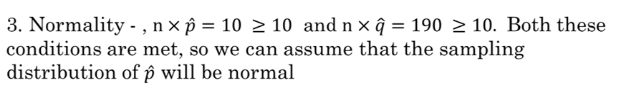

b) List and verify each of the conditions:
1. SRS – it is stated that a SRS of 200 bananas will be taken
2. Independence – the condition of each banana is independent of one another. So it’s safe to assume the bananas are independent
We would reject the shipment if 10% or more of the sample is defected
Lower limit: 0.10
Upper limit: 10e99
Assuming that the shipment is more than 2000 bananas, the probability of rejecting the shipment is very unlikely.

Slide 9
Ex: Suppose we have a larger shipment of bananas. We took a random sample of 300 bananas and found that 16 of them are defective.
a) Create a 95% confidence interval for the percentage of bananas that are defective
b) Check if all conditions are met to conduct an inference procedure
c) Interpret your confidence interval
d) If 5% of a shipment is defective, the entire shipment is rejected. Should you reject this shipment?

Slide 10
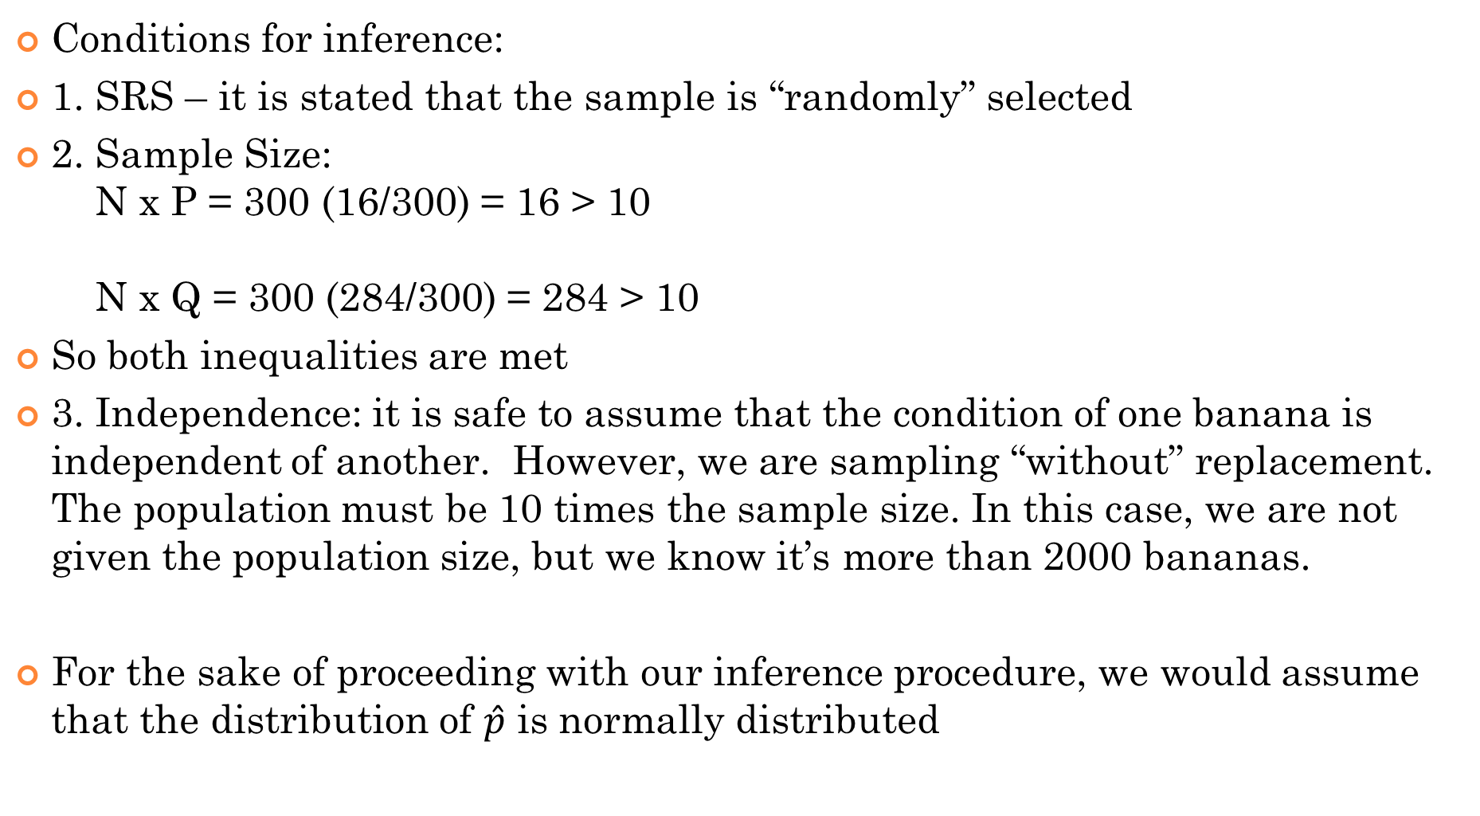
Conditions for inference:
1. SRS – it is stated that the sample is “randomly” selected
2. Sample Size: N x P = 300 (16/300) = 16 > 10 N x Q = 300 (284/300) = 284 > 10
So both inequalities are met
3. Independence: it is safe to assume that the condition of one banana is independent of another. However, we are sampling “without” replacement. The population must be 10 times the sample size. In this case, we are not given the population size, but we know it’s more than 2000 bananas.
For the sake of proceeding with our inference procedure, we would assume that the distribution of $\hat{p}$ is normally distributed

Slide 11
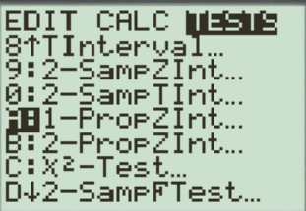
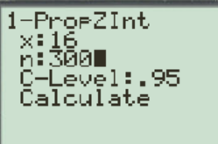
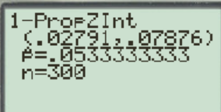
We took a sample of 300 bananas and 16 of them are defective
We are 95% confident that the proportion of bananas in the shipment that is defective is between 2.79% to 7.88%

Slide 12
what happens when we sample without replacement?
When we sample without replacement, the probability of selecting a defective banana is affected by prior selections
Which means that the probability of selecting a defective banana is affected after each selection → each observation you get is NOT independent
In general, if the population is much bigger than your sample, then the effect of sampling without replacement on independence is negligible
Ie: [Rule of thumb] if population is 10 times or more than sample, then we can claim independence despite sampling without replacement
In advanced statistics, a “Finite Population Correction” (FPC) factor is used to adjust the SE of the sampling distribution when sampling without replacement is used

Slide 13
Conditions for Estimating a Population Proportion:
When creating a confidence interval to capture the population proportion (p), these conditions must be met:
The sample must be from a Simple Random Sample
Normality: the sample size must be big enough to meet the two inequalities. This is to ensure that the sample is big enough so the sampling distribution is normal
Independence: Each observation is independent of one another. If there is sampling with no replacement, the population size must be at least 10 times the sample size

Slide 14
Ex: In the Harvard School of Public Health survey, A S R S of 1 0, 9 0 4 students across many U S colleges were surveyed on their drinking habits. 2105 of the 10,904 respondent were classified as non-drinkers. What is the true proportion of college students that are non-drinkers?
a) Define the population and parameter of interest
b) Confirm that the conditions for constructing a confidence interval for the true population proportion ‘p’ are satisfied
c) Calculate a 99% confidence interval for “p”
d) Interpret the interval in the context of this problem

Slide 15
a) The population is all college undergraduates, and the parameter of interest is:
b) The question indicates that it is from a SRS. The population is atleast 10 times the sample size of 10,904 (independence). The two conditions for normality are also met:
c) 99% Confidence Interval:
d) Interpretation: We are confident that the true percentage of US college students that are non drinkers are between 18.3% to 20.3%.

Slide 16
Ex: A researcher would like to estimate the proportion of adults who are numerically competent. A SRS of 300 adults were tested and only 68 passed.
a) Construct and interpret a 90% confidence interval for the true proportion of adults who are numerically competent
(Make sure all conditions are met for constructing a C.I.)
b) Suppose we want the margin or error to be within 2% at a 95% confidence level. How large of a sample is needed?

Slide 17
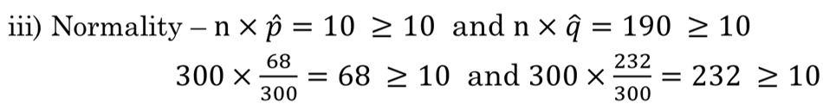
a) First check that all the conditions for creating a confidence interval are met:
i) SRS – it is given that the sample is a SRS
ii) Independence – we would assume that the population of adults is greater than 680 (which is 10 times the sample size)
Conditions for normality are met
Using ti83 , 1-PropZint, we get a 90% C.I. of (0.18691,0.26643)
We are 90% confident that the population proportion of adults that are numerically competent is within the interval of 18.691% to 26.643%
b) To get a margin of error within 2% of a 95% C.I, we have:
1682.91

Slide 18
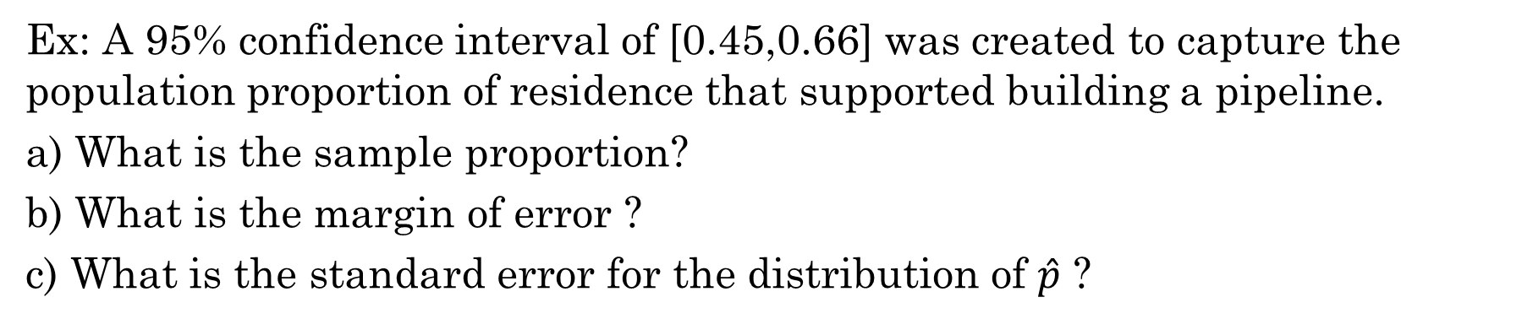
Ex: A 95% confidence interval of [0.45,0.66] was created to capture the population proportion of residence that supported building a pipeline.
a) What is the sample proportion?
b) What is the margin of error ?
c) What is the standard error for the distribution of $\hat{p}$ ?

Slide 19
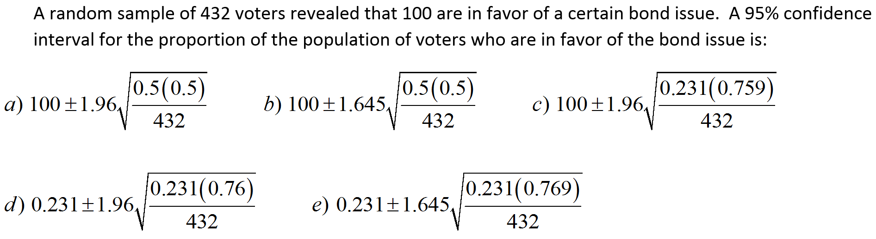
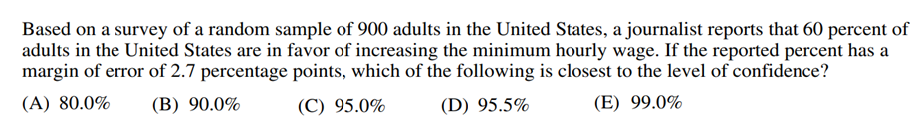
The report of a sample survey of 1,014 adults says “With 90% confidence, between 37% and 44% of all Canadians are married”. What does the phrase 90% confidence mean?

Slide 20
NOTE: First, we are looking for CI for proportion, not based on sample mean. So we won’t need μ_{x}
Instead, the formula we will be using is:
For a 95% CI, the Z-value will be 1.96
Answer: “D”

Slide 21
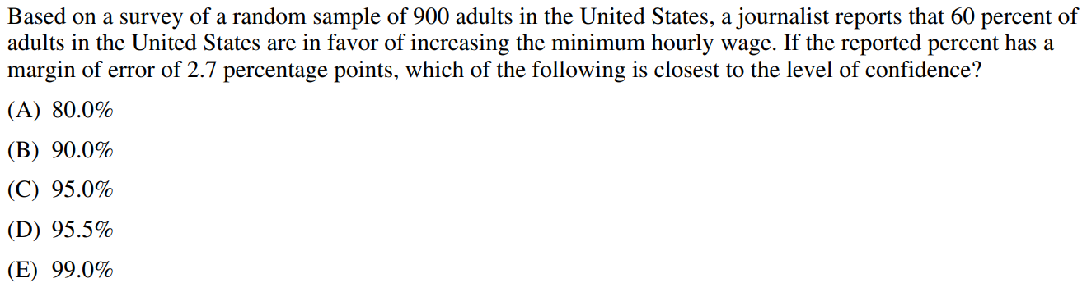
Margin of Error is less than 2.7%
Use this z-score to find the tail area
Gather info:
n=900
One tail is about 5%, so both tails is 10%
Confidence interval is closest to B) 90%

Slide 22
The report of a sample survey of 1,014 adults says “With 90% confidence, between 37% and 44% of all Canadians are married”. What does the phrase 90% confidence mean?
We can be 90% confident that the method used to get the interval always gives the right answer
37% to 44% of all Canadians will spend 90% of their lives married
There is a 90% chance that the percent of people who are married is between 37% and 44%
The method used to get the interval from 37% to 44%, when used over and over, produces intervals which include the true population percentage about 90% of the time
95% of all Canadians will be married between 37% and 44% of the time
Answer: D

Slide 23
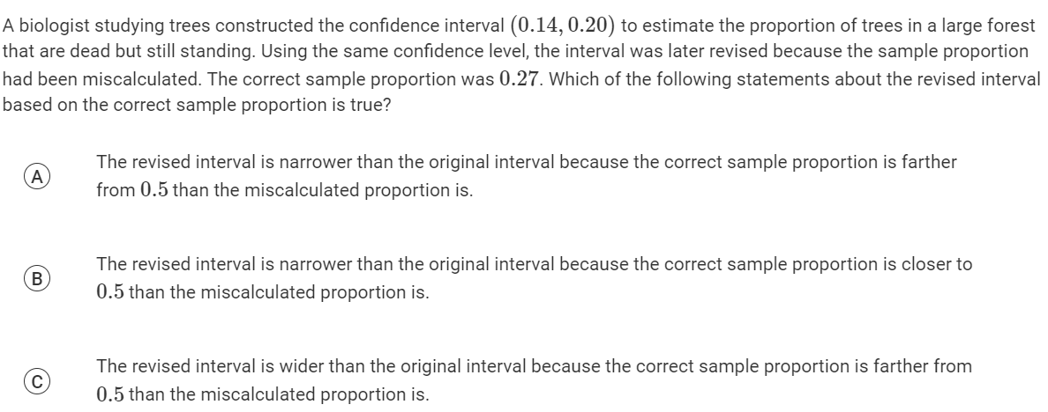
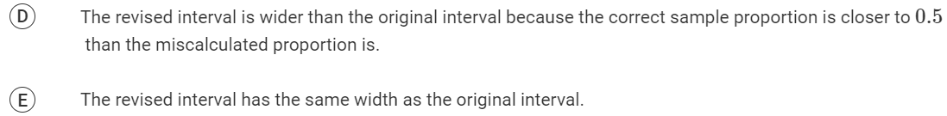

Slide 24
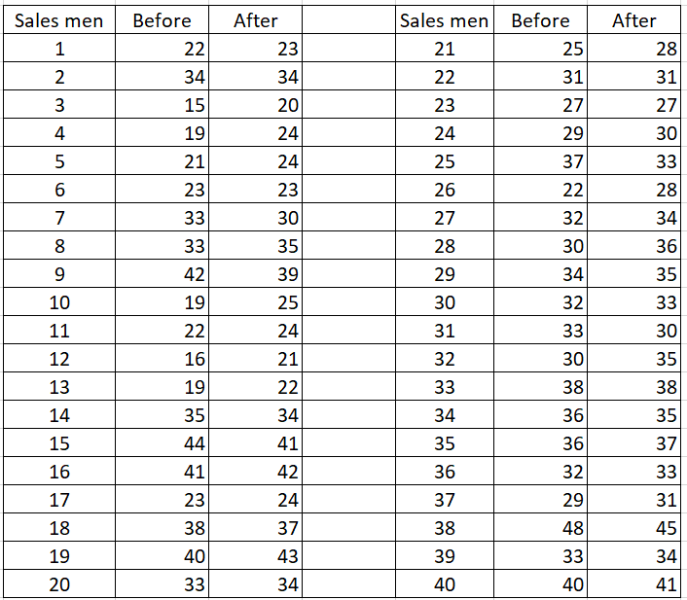
50 salesmen were enrolled in a marketing class to help improve their monthly sales. The list provided shows their 5 month average before the class and their 5 month average after taking the class. Sales are measure in $1,000.
a) If we are inspecting on whether if sales increased, what type of interval should we look for? Z-int? T-int? Prop Int? Explain
b) Find a 95% confidence interval for the improvement in sales after taking the course. Make sure conditions are met
c) Does the confidence interval suggest that there is an improvement in sales? Explain:

Slide 26
Activity 10C: Capturing “P”
This activity is to estimate the true population proportion “p”
Suppose you have a 10 sided die and numbers 1,5,7 are considered as success. The other numbers are considered as failures. Now, suppose you didn’t know that the population proportion for success was 30%.
Roll the dice 50 times and calculate the sample proportion of success.
Now using the sample proportion, create a 95% confidence interval for p.
In your class, what percentage of the class had a confidence interval that captured the true population proportion p?

Slide 27
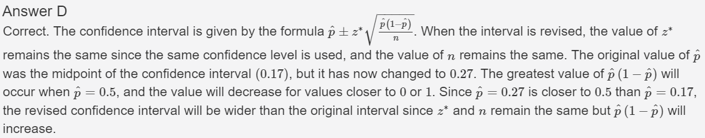

Slide 28
Deriving the Mean and Standard Error for the sampling distribution of $\hat{p}$
Review: the mean and standard deviation of a binomial distribution is:
We are starting with a binomial distribution b/c every data point is binary, has only two outcomes
The mean is defined as the average number of success in “n” trials
If the distribution is normal, within 1 std dev is 68% of the data points
Moving on to proportions, a proportion is defined as the number of success divided by the number of trials
The number of success in a binomial event
proportions
Divided by
The number of trials

Slide 29

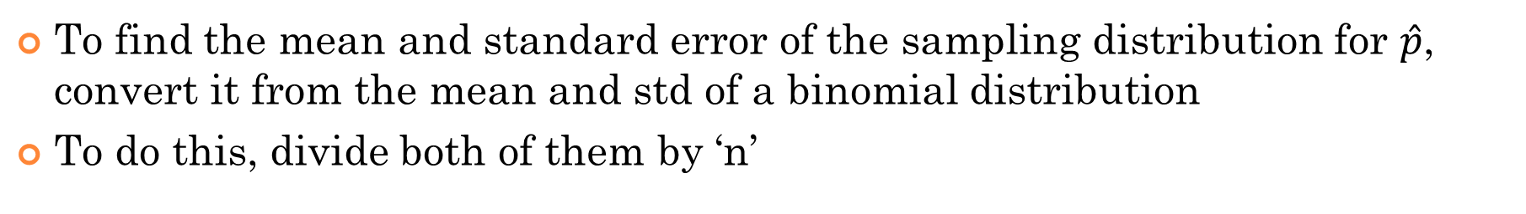
To find the mean and standard error of the sampling distribution for $\hat{p}$, convert it from the mean and std of a binomial distribution
To do this, divide both of them by ‘n’
BINOMIAL DISTRIBUTION:
Sampling Distribution of $\hat{p}$

